Slide 1
Survey of the Industry

Slide 2
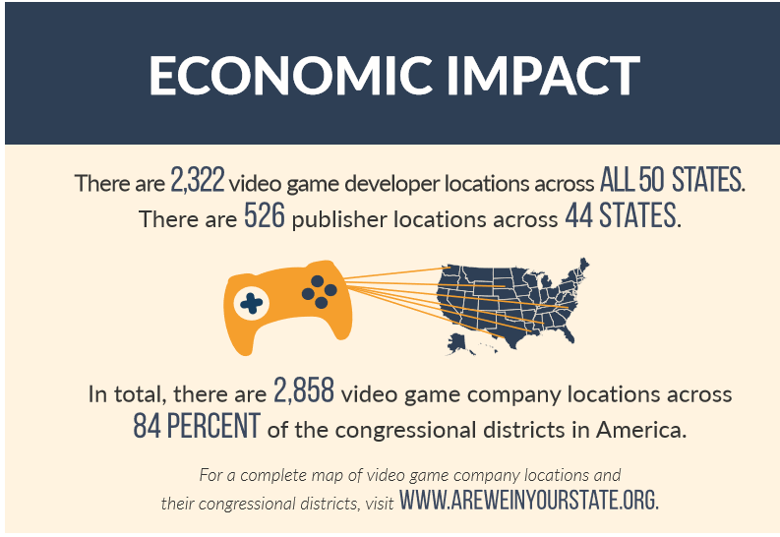
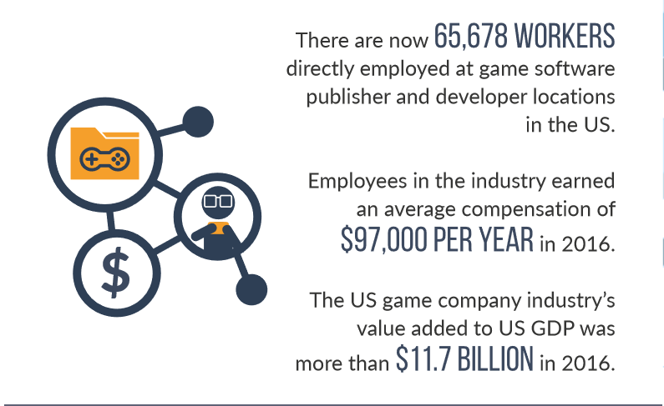
Impact on the Economy
Source: Copyright © http://www.theesa.com, ESA Releases 2017 Annual Report

Slide 3
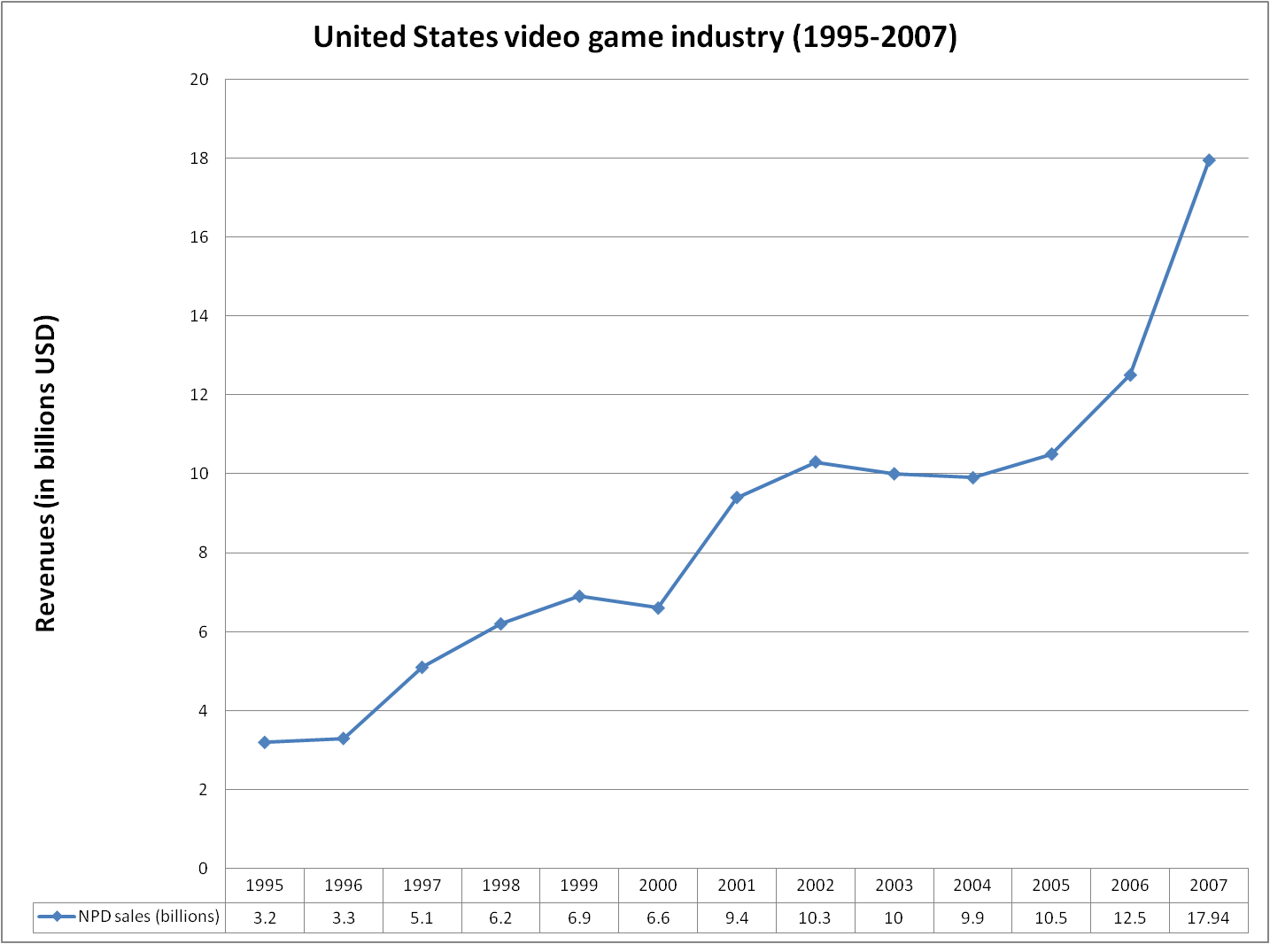
Source: Copyright © http://vgsales.wikia.com/wiki/File:Us_revenues_1995-2007

Slide 4
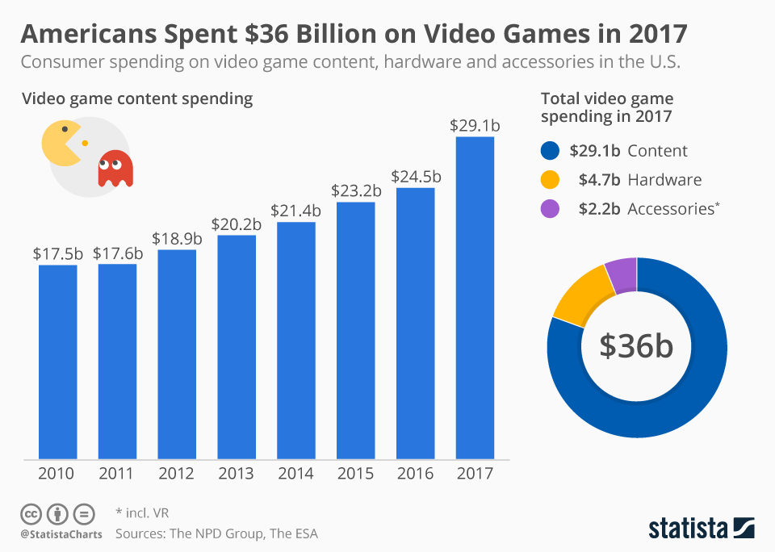
The Game Industry: US Market

Slide 5
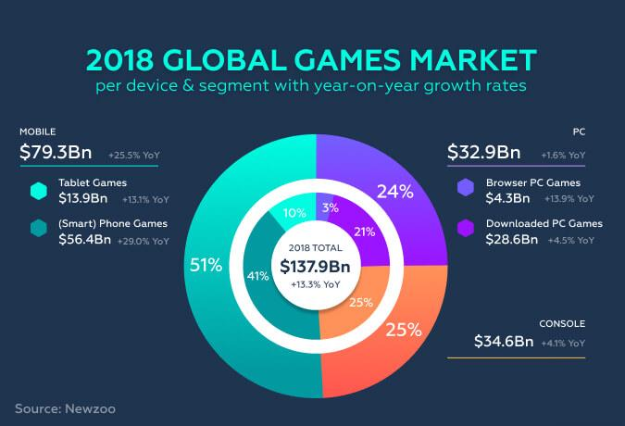
The Game Industry: World Wide Market

Slide 6
The Game Industry: Market Drivers
Average Age of Video Gamers:
35

Slide 7
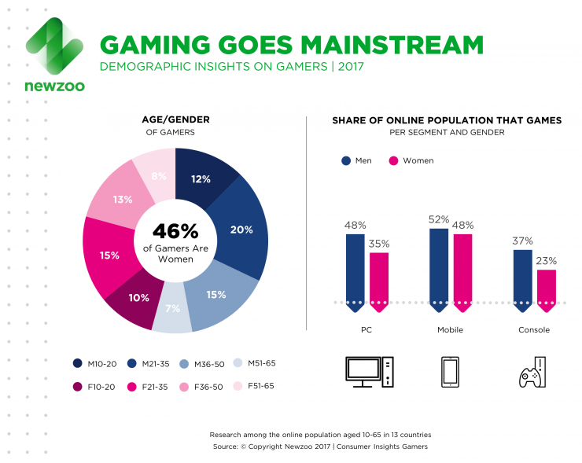
Worldwide Game Industry: Demographics

Slide 8
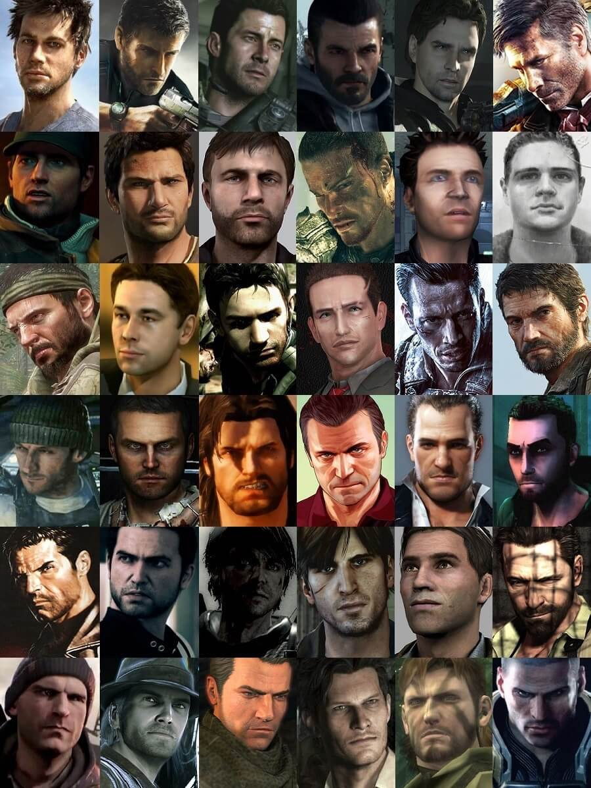
Industry Issues
Misogyny, sexism and progressivism in video game culture
Gamer Gate
Stereotyping
Main characters match the Developers
Gender Diversity
In-game
In-industry
Racial Diversity
In-game
In-industry
Source: https://gamerant.com/average-video-game-heroes/

Slide 9
Market Drivers
Total number of video gamers worldwide:
2.5 Billion
(about 50% spend money on video games)

Slide 10
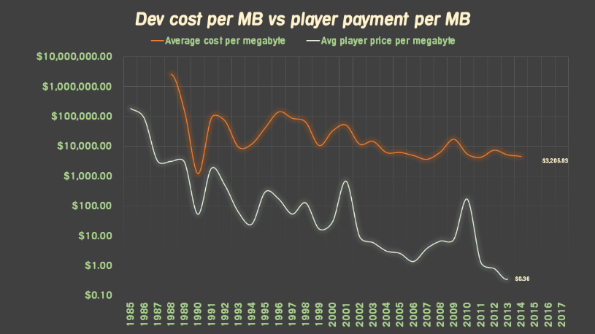

Slide 11
AAA Game Industry response: Sequels
What game’s 5th iteration’s 1st week domestic sales ($310M) beat
Black Panther’s 1st week domestic sales ($292M)
&
Infinity Wars 1st week domestic sales ($250M)
?

Slide 12

The Game Industry: Sequels…..

Slide 13

The Game Industry: The biggest Sequel of all…..
Total Sales: 100,000,000 Units
Total Revenue > $6 Billion

Slide 14
The Future of the Industry
Consoles
Will continue to be successful
Pros
Consistent Tech (doesn’t have the constant upgrades required in a PC)
Consistent Quality (Sony and MS have standards in regards to bugs)
Relatively cheap
Advancements in look, audio, and social gaming will give them a long life
They will remain the premium experience
Cons
They do outdate
There is no small model on console
Tablet & Mobile Gaming (iOS & Android)
Huge market with an even higher level of competition
Cost of entry is low, success is now elusive (too much competition)
IPs (Intellectual Properties) are becoming very important

Slide 15
The Future of the Industry
PC Gaming
Steam vs. Epic Store
Game Subscriptions Services: Download and play a large portfolio of games for a monthly price
Sony PS Now
Xbox One Pass
EA Access
Apple Arcade
Jump
Utomik
Cloud Gaming: The game runs on a virtual game system (hi end) and is served to your chosen platform
Stadia (Google)
Microsoft Project XCloud
Sony PS Now
NVIDIA GeForce Now

Slide 16
The Future of the Industry
VR (virtual reality)
VR Pros
New Platform (30% of hardcore gamers are interesting in adding it to their systems)
Very Immersive
VR Cons
Currently needs a High End system to really experience it properly.
Movement (in game and real time)
Interface
VR Growth Potential
Arcades (controlled environments)
Growing but niche platform/PC market, needs a big hit
Business (teaching sales, HR, communication)
AR (augmented reality)
AR is not as developed as VR (AR potential will be fulfilled with light, powerful glasses that aren’t connected to anything)
AR Potential is very high (HoloLens2 is technical forefront)
Pokemon GO

Slide 17
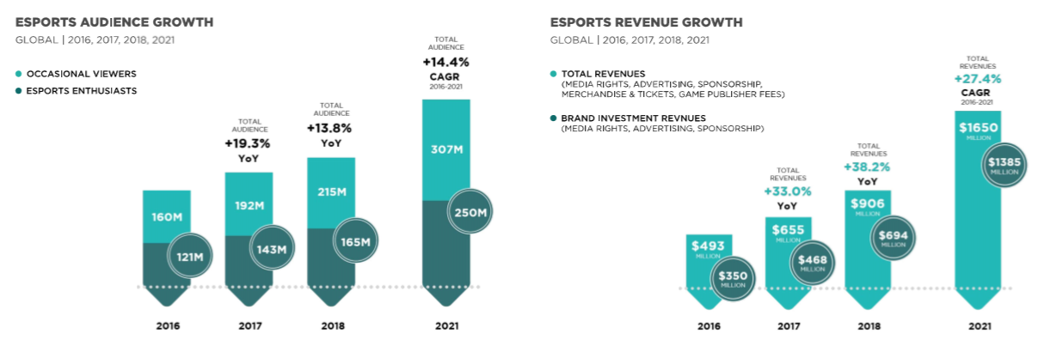
The Future of the Industry
The Emergence of eSports
Source: Copyright © 2018 Newzoo/ Global Esports Market Report 2018

Slide 18
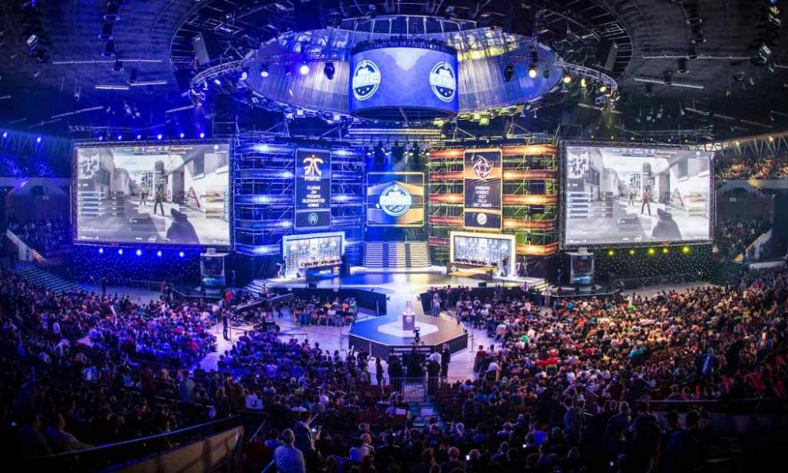
Source: Copyright © www.talkesport.com / ESL One Cologne 2017

Slide 19
Indie Development
Pros
Easy to start up with lower costs, low overhead
Control over content (you can build whatever you want)
Multiple platform targets
Small team communication, integration and teamwork
Cons
Not strong in production/finance support
Easy to fail the “bus test”
Competition is very large, potentially negative financially
Indie Preference of Platform
PC for ease of development, broad audience on Steam, maybe too broad…
Switch for price point though it isn’t easy to develop for
PS4 is indie friendly but not a preference
Xbox One least preferred but very easy to work with and on
Both MS and PS4 have indie stores

Slide 20
Large Studio Development
Your studio culture will be a reflection of the owner, this can be good or bad
Pros
Financially secure (as long as the products don’t fail)
Career advancement
A network of high end jobs in certain areas of the country
Expertise advancement via mentoring and team dynamics
Workloads are often tempered (few studios do the 100 hour workweek anymore)
Cons
You don’t control the products you work on
Expensive so failure is not an option
Effective Communication can be difficult
Very process driven which can feel stifling
Politics can be a problem

Slide 21
Video game Organizational Information
Studio Structure

Slide 22
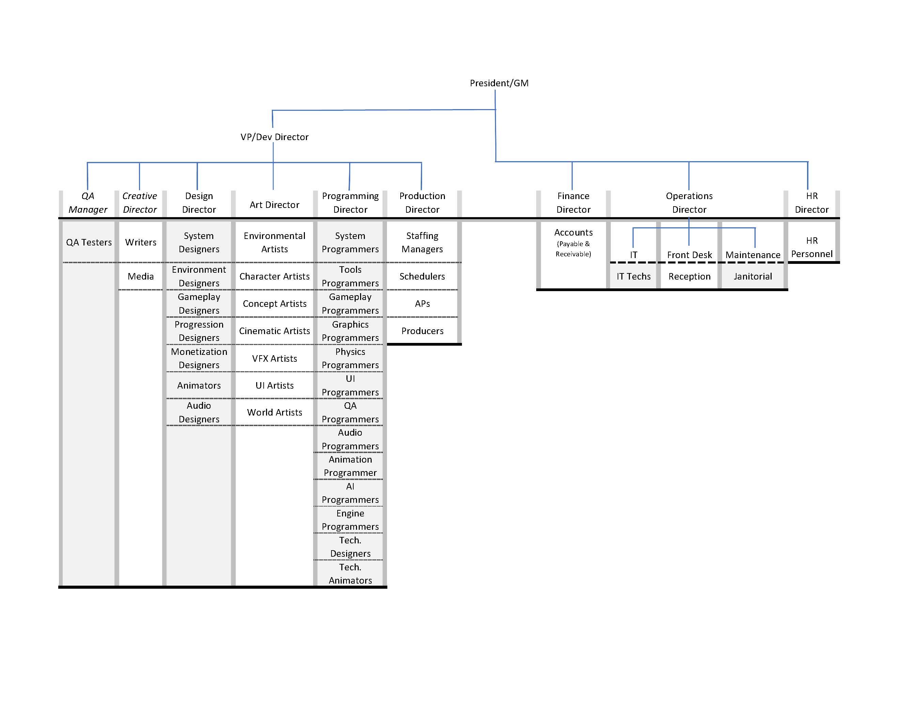

Slide 23
Thoughts on Studio Structure
Checks and balances
Dev and Finance
Matrix system
HR as a neutral party
Career Path (5 Levels, 3 steps per level)
Entry/Assistant
Associate
Regular
Senior
Principal
Merit based, promos based on: skill, growth, impact, communication
Review System

Slide 24
Thoughts on Studio Structure - continued
Disciplines built around similar needs (trying to keep the management team small and focused)
Tech Design and Tech Art part of Programming
Audio & Animators are part of Design
Discipline Directors as Quality Drivers, not managers
Keep the Discipline cutting edge
Remove the weak links uncovered via development
Staffing Managers
Monthly one on ones
Feedback process
Talk about environment, team, team members
Work across disciplines supporting the same level in all disciplines

Slide 25
Video game Organizational Information
Project Structure

Slide 26
 |  |  |  |  |  | Producer
 |  | Creative Director |  |  |  |  |  | Tech Director
 |  |  |  |  |  |  |  |  |  | Production Team
Art Director |  | Design Director |  | Narrative Director |  |  |  | Programming Director
Character Pipeline |  | Gamplay Team |  | Narrative Team |  |  |  | Engine Time |  | Outsourcing
City Builder Team |  | Mission Builder Team |  | Cinematics |  |  |  | Tools Team |  | QA
Vehicle Team |  | Progresssion Team |  | Voice |  |  |  | Systems Team |  | Localization
Weapons Team |  | Open World Team |  |  |  |  |  | Build Team |  | THE PROJECT
Customization Team |  | Monetization Team |  |  |  |  |  | MP Infrastructure Team
 |  |  |  |  |  |  |  | AI Team
 |  |  |  |  |  |  |  | Support Team

Slide 27
Dev Teams
City Builder Team |  |  | Vehicle Team |  |  | Character Pipeline |  |  | Systems Team
 | Env Artists |  |  | Artist Modeller |  |  | Concept Artist |  |  | Programmers
 | Env Designers |  |  | Artist Texturer |  |  | Character Modeller |  |  | Tech Designers
 | Open World Designer |  |  | Tech Animator (rigging) |  |  | Character Texturer |  |  | Tech Artists
 | Support Team |  |  | Animator |  |  | Tech Animator (rigging)
Mission Builders |  |  |  | Support Team |  |  | Animator |  | Progression Team
 | Game Player Programmers |  |  |  |  |  | Audio (Voice) |  |  | Progression Desinger
 | Game Player Designers |  | Open World Team |  |  |  | Combat Designer |  |  | Support Team
 | City Builder Team |  |  | Open World Designer |  |  | Weapons Designer
 |  |  |  | Support Team |  |  | Writer |  | Monetization Team
Tools Team |  |  |  |  |  |  |  |  |  | Monetization Designer
 | Tools Programmers |  | AI Team |  |  | Narrative Team |  |  |  | Support Team
 | Tech Artists |  |  | AI Programmers |  |  | Writers
 | Tech Designers |  |  |  |  |  | Designers |  | MP infrastructure Team
 |  |  | Support Team |  |  |  | Audio |  |  | Programmers
Engine Team |  |  |  | Concept Aritst |  |  | Game Programmer (viability)
 | Graphics Programmers |  |  | Shader Artists |  |  |  |  | Build Team
 | Physics Programmers |  |  | VFX Artists |  | Weapons Team |  |  |  | Programmers
 | Architects (Programmers) |  |  | Audio Designers |  |  | Artist (Modeller)
 | Systems Programmers |  |  | Tech Artists |  |  | Artist (Texturer) |  | Customization Team
 | Lighting Programmers |  |  | UI Team |  |  | Artist (VFX) |  |  | Customization Designer
 |  |  |  |  |  |  | Combat Designer |  |  | Support Team
 |  |  |  |  |  |  | Support Team

Slide 28
Team Dynamics
The Creative Director owns the vision of the game
The Technical Director owns the viability of the feature set
Each Team has a Lead or coordinator (if the group is too small)
Determined by skill and communication ability
Each Team is assigned a scheduler and an AP (Associate Producer)
They drive the team forward, keeping them focused and on track
The Directors have to own and drive the high level elements
Art: Style & consistency (this does not mean moving individual items around)
Design: The player experience
Programming: Scope
Production has to drive all of this with a very small staff……..

Slide 29
When Things go sideways
Strike Team
Scope Changes
Date Changes
Cancellation

